Slide 1

End of Course Project(20 Credits)
Bharath Reddy Nagasetty-60027
Vishal Kumar Singh-60030

Slide 2

Introduction
Divided into two Parts:
Creating a web application interface for an user to use the Translator.
Designing the Grammar for the Pseudocode using Python based TextX.

Slide 3

Web Frameworks
A web framework or web application framework is a software framework that is designed to support the development of web applications including web services, web resources, and web APIs.
Different Frameworks available for python are:
Django
Flask
CherryPy
Pyramid

Slide 4
Flask
Flask is a micro web framework written in Python.
It is called a microframework because it doesn’t need any particular tools or libraries.
Flask was created by Armin Ronacher of Pocoo, an international group of Python enthusiasts formed in 2004.
It is considered as the best framework for building a web application for beginners.
It was designed for applications that are open-ended. Flask has been used by big companies, which include LinkedIn and Pinterest.

Slide 5
1.Designing an interface
The web interface consists of the following Files:
Python Program for the Flaks Controller
“Templates” which contain all the HTML Documents required for the Website.
The following requirements are needed before developing the flask application.
Python: https://www.anaconda.com/
Editor (Preferable VS code or Atom)
Flask : https://pypi.org/project/Flask/
Should have basics about HTML and JS

Slide 6
Procedure
1. Create a virtual environment and install flask in that particular environment.
To create a environment use the conda terminal and type “conda create -- name <env name>
To activate the environment use activate <env name>
2. Create two web pages named Home and Display with an extension .HTML which will act as a interface and place them in a folder called templates.

Slide 7
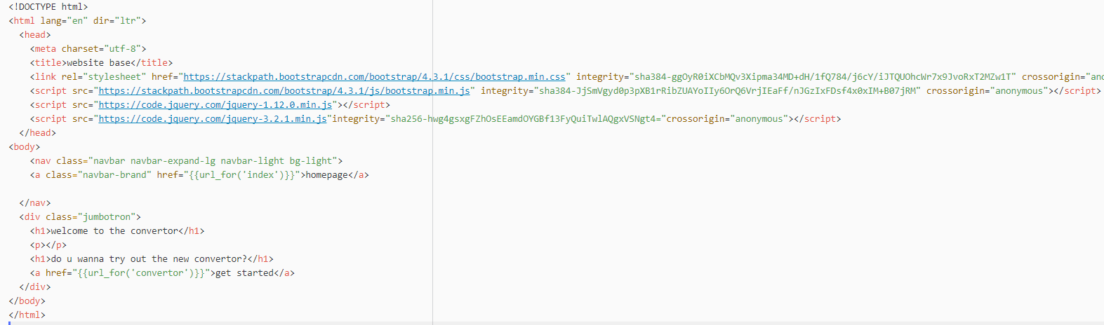
Home Page

Slide 8
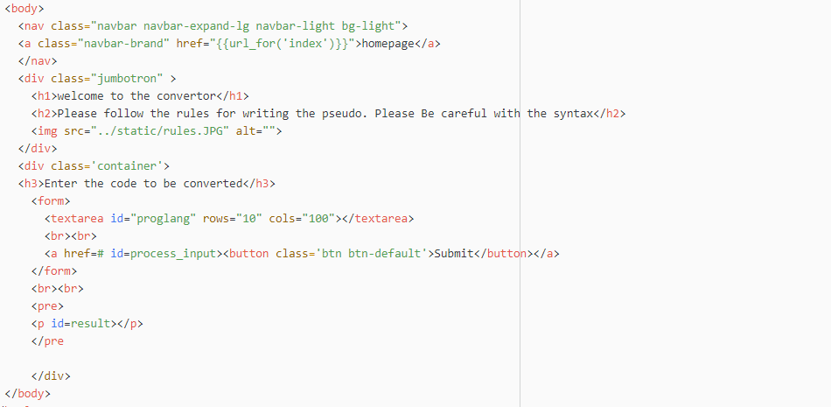
Display

Slide 9
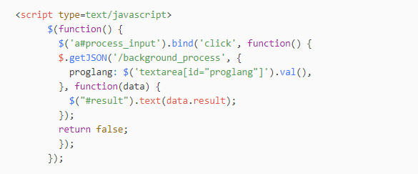
Java Script for Asynchronous Display

Slide 10
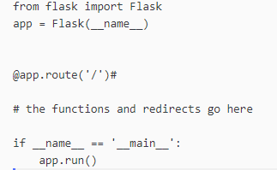
Flask Controller
The flask program is the main controller which manages the working of the web application.
The basic structure of the program is:
To enable the debugger add debug=TRUE in the app.run()

Slide 11
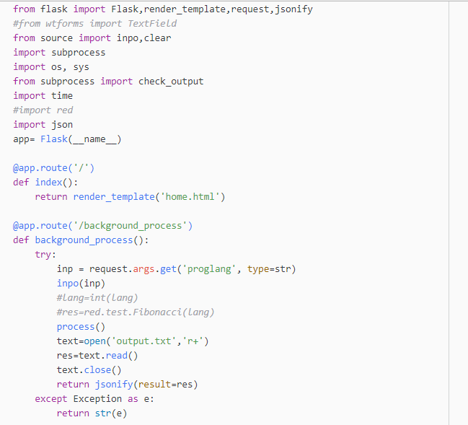
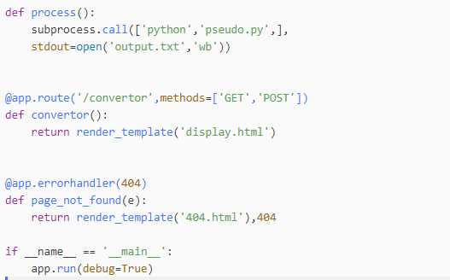
The controller program

Slide 12
2. Designing the Grammar

Slide 13
DSL
A Domain Specific Language(DSL), is a language that’s specialized to a particular application domain.
Domain Specific Languages can be extremely specific.
Well-known DSLs include regular expressions, markdown, extensible markup language (XML), and structured query language (SQL).
A DSL may be specialized to a particular problem domain, a particular problem representation technique, a particular solution technique, or other aspects of a domain.

Slide 14
TextX
textX is a meta-language (i.e. a language for language definition) for domain-specific language (DSL) specification in Python.
textX automatically builds a meta-model (in the form of Python classes) and a parser for your language.
The parser will parse expressions of your language and automatically build a graph of Python objects (i.e. the model) corresponding to the meta-model.

Slide 15
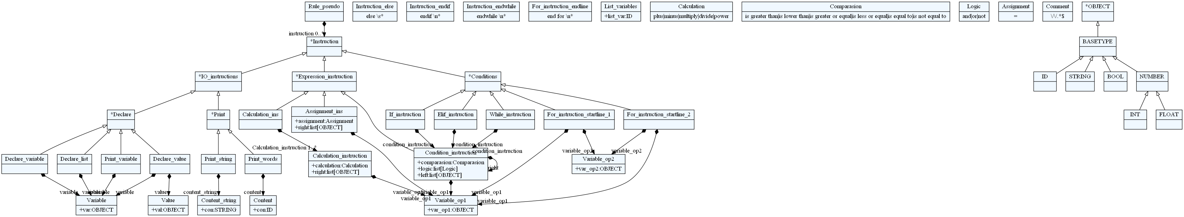
AST

Slide 16
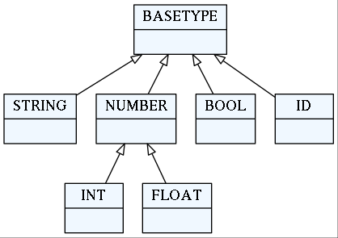
Base Types
There are 5 base types in textx.
ID:matches a common identifier consisting of letters,
digits and underscores.
INT: matches an integer number.
BOOL: matches the words true or false.
STRING: matches a quoted string.
FLOAT: will match a floating point number.

Slide 17

Grammar
The grammar generated used in this project can be understood very easily.
Rule_Pseudo is the base rule from which all the rules get generated.
Here a ‘*=‘ is a combination of assignment and repetition operator, where * is Zero or more repetitions.
The LHS is always a name of the meta-class attribute while the RHS can be a reference to other rules.

Slide 18

Instructions
Instructions are divided into three types:
Each of the instructions will act as the meta types for the sub instructions.
IO_instructions are further divided into print and declare rules.
Expression_instruction is divided into Calculation, Condition and Assignment Rules.
The condition rule constitutes the if condition, for , while loop rules.

Slide 19

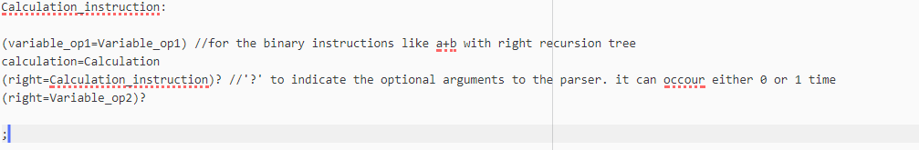
Calculation Instruction
The calculation instruction consists of a /\s*/ so as to enable
Other calculation instructions to be defined after a line ends.
An ‘eolterm’ is added so as to inform the parser not to continue parsing the same instruction defined after the end of a line.
Here a right recursion tree is being used to generate the an AST. A calculation tree will be built if there are more than one calculation conditions.

Slide 20
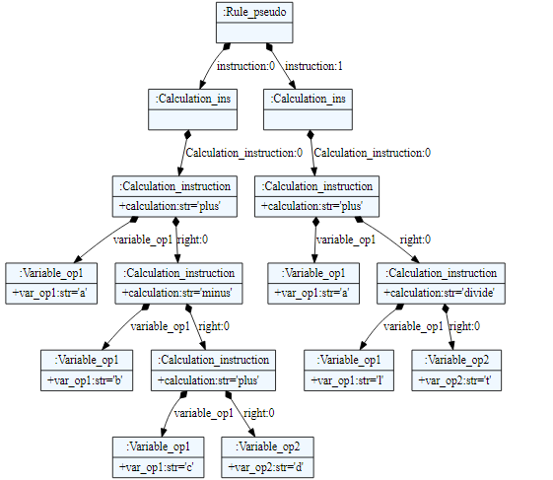
Calculation Instruction
INPUT:
a plus b minus c plus d
a plus l divide t

Slide 21
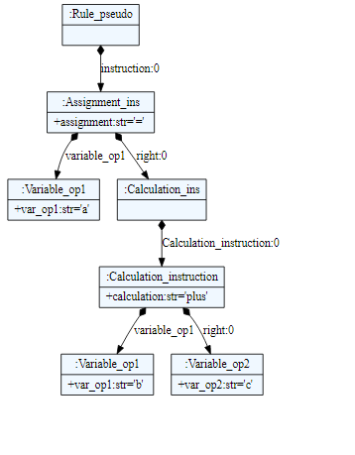
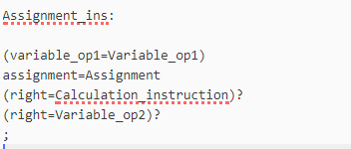
Assignment Instruction
The assignment rule is used to equate the expressions using
an ‘=‘ operator.
Input: a= b plus c

Slide 22
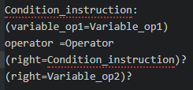
Condition Instruction
A condition rule is used to specify a comparison or logic operation.
Here the two variables are used to store the operands and the user is free to choose between the logic and Comparison and if more than two conditions are provided a recurring tree will be produced.

Slide 23
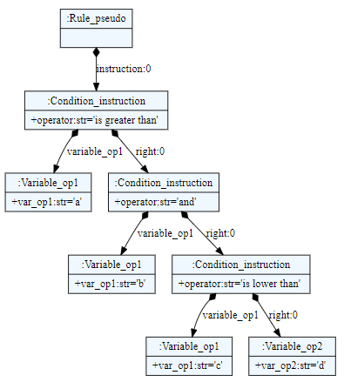
Condition Instruction
INPUT:
a is greater than b and c is lower than d

Slide 24
IF Instruction
The if instruction is based on conditional rule with a prefix of ‘if’ keyword.
The if keyword differentiates the rule from other rules.
The if keyword is followed by a conditional rule which is used as a reference in if rule.
The elif condition is also similar to the if condition but the only difference is the keyword.
The ‘endif’ keyword marks the end of a particular if statement.

Slide 25
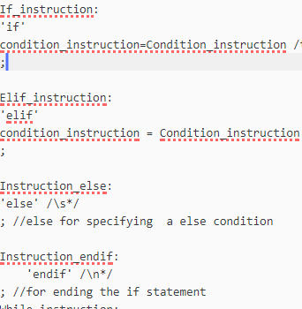

Slide 26
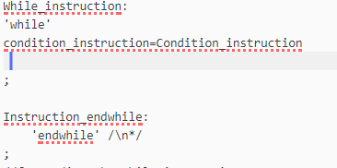
While Loop
The while rule is same as the if rule but only the keyword is different.
The while rule uses ‘while’ keyword.

Slide 27
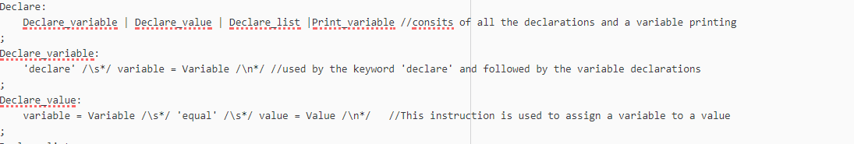
I/O Instruction
The I/O instruction consists of declare an print statements.
The declare is divided into declare value(used to assign values to variable), declare variable( used to declare variable). All the declare rules have a prefix of ‘declare’ keyword.
The print is divided into Print String and Print Variable. All the print rules have a prefix of ‘print’ keyword.

Slide 28
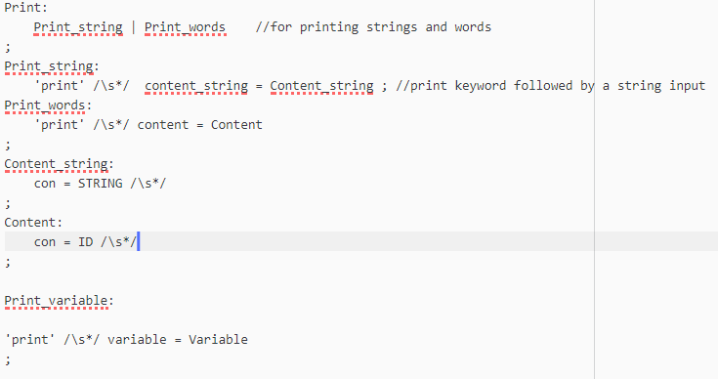

Slide 29
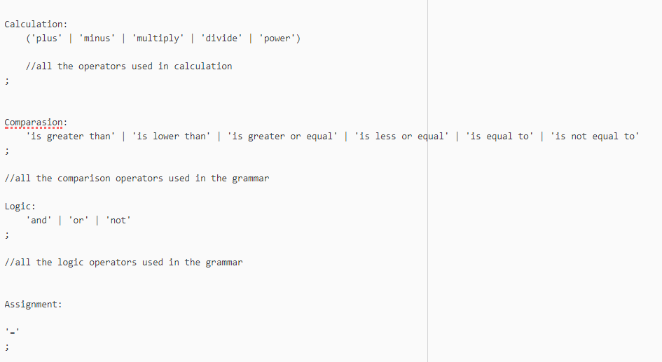
Operators
Comparison, Logic, Calculation and Assignment operators are used in the construction of grammar.

Slide 30
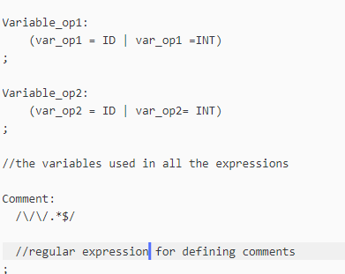
Variables and Comments
Variables constitute the main parts of the grammar. They are present in every operation.
Two variables are defined in the grammar which can take an input as id and int.
The comment in this grammar is defined according to the ‘C’ programming language.
The comment starts with // and continues till the end of the line.

Slide 31
Thank You

